Slide 1


K.RAMAKRISHNAN COLLEGE OF TECHNOLOGY
(AUTONOMOUS), TRICHY.
DEPARTMENT OF
COMPUTER SCIENCE AND ENGINEERING
20CS5501 DESIGN PROJECT-1
Batch No. : 21
Date : 05.12.2024

Slide 2

Tourist Management System
Guided by
V.Sowmiya M.E,.. AP/CSE
Team:
M.Fayas ahmed (811722104041)
J.Ignatiuss (811722104055)
L.Infant alan (811722104057)

Slide 3
OBJECTIVE OF THE PROJECT
Centralizing information and services for tourists, including accommodations, transport, tours, and attractions.
Enabling easy booking and reservation management for users.
Facilitating real-time communication between service providers and tourists.
Enhancing data analysis for better decision-making in tourism management.
Supporting sustainable tourism practices by efficiently managing resources.

Slide 4
ABSTRACT
Nowadays tourism website can't give an adaptive package in its own suggestions. and can't get a package from inbuilt database by its predefined user's packages. Gather data from users through surveys, reviews, and interaction logs. This data will serve as the foundation for understanding user preferences and behavior by creating a loop to look to its feedback. Create a feedback loop where users can rate and review the recommendations they receive. Databases NOSQL databases for storing user data and feedback. Data Warehousing tools such as JSON is used for aggregating and analyzing large datasets.

Slide 5
LITERATURE SURVEY
TITLE OF THE PAPER | AUTHOR (S) | PUBLISHER | TECHNOLOGY USED | DRAWBACKS
“Tourism Management Systems: A review of Current trends and Future of Direction” | M.A. Ahmed, S.K. Singh and R.K. Singh | Journal of tourism Management system(JTMS) | Cloud computing IoT and module application | Limited Scope of Data Overemphasis on Technology
“Data analytics in Tourism Industry: A review and Future Directions” | S.K. Singh, R.K. Singh and A.K. Singh | International journey of Data analytics(UDA) | Machine learning, Data mining and Business intelligence | Overemphasis on Big Data Lack of Focus on Ethical and Privacy Concerns
“Sustainable Tourism Management: A Review and Future Directions” | A.K. Singh, R.K. Singh , and S.K. Singh | Journal of sustainable Tourism(JST) | Green Technology, Renewable Energy and Eco-Friendly Practices | Lack of Practical Implementation Strategies Lack of Practical Implementation Strategies
“Tourism Marketing Management : A Review and Future Directions” | R.K. Singh, S.K. Singh and A.K. Singh | International journey of Marketing studies(IJMS) | Digital marketing, Social media and CRM | Failure to Address Economic Viability Neglecting the privacy.

Slide 6
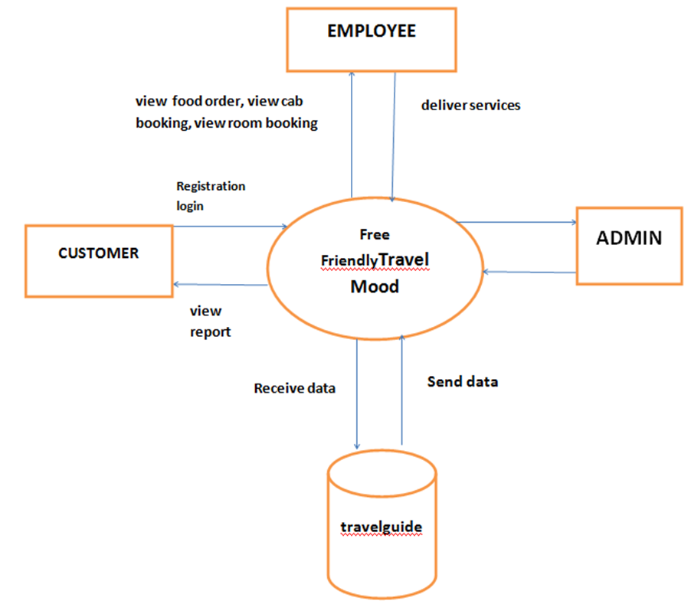
PROPOSED SYSTEM ARCHITECTURE
SERVICE PROVIDER
USER SERVICE
USER REVIEW
TRAVEL PACKAGES
DATABASE

Slide 7
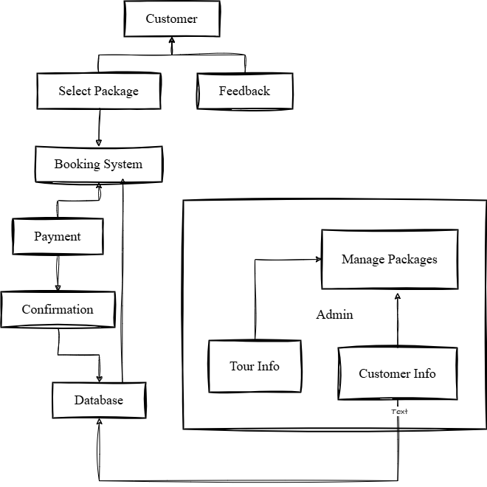
EXISTING SYSTEM ARCHITECTURE

Slide 8
SOFTWARE AND HARDWARE REQUIREMENT
HARDWARE
SOFTWARE
Hard disk -128GB
RAM - 2GB(minimum require)
Processor – Dual Core or Above.
Display – RGB Monitor
Front end- Html,CSS(Framework: Bootstrsap),Javascript
Back end - Php
Database - Mysql
Tool - VS Code

Slide 9
MODULES
User Registration and Login
Destination Management
Booking and Reservation
Tour Packages and Itinerary Planning
Feedback and Customer Support

Slide 10
SUMMARY OF MODULE-1 (User Registration and Login)
1.The system starts with user registration, allowing users to create accounts with personal information and preferences.
2.Account management - Users can update their personal information, change passwords, and manage their booking history.

Slide 11
SUMMARY OF MODULE-2 (Destination Management)
1.The system provides comprehensive information about various destinations, covering attractions, activities, and travel tips.
2.Having this information really help for travels plan their trips, enhance their overall experience in destination.

Slide 12
SUMMARY OF MODULE-3 (Booking and Reservation)
1.Booking: Customer information,travel dates/times, product or service selection.
2.User can reserve activities such as tour sightseeing, cultural experiences and adventure activities.
3.Customer confirms reservation within the expiry time.

Slide 13
SUMMARY OF MODULE-4 (Tour Packages and Itinerary Planning)
1.The system offers pre-designed tour packages and allows users to create customized itineraries.
2.Users can browse and choose from a variety of curated tour packages based on their interests.

Slide 14
SUMMARY OF MODULE-5 (Feedback and Customer Support)
1.The system offers 24/7 customer support through various channels, including email and phone. This ensures that travelers can receive assistance whenever they need it.
2.The system encourages user feedback to improve the overall travel experience. Feedback can be submitted through online surveys, rating systems, and direct communication channels.

Slide 15
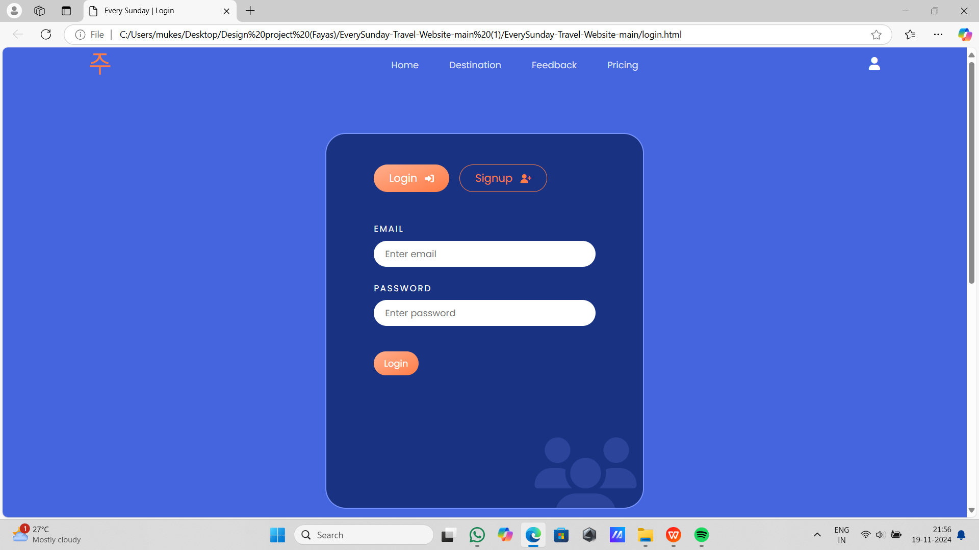
RESULTS AND DISCUSSION
MODULE-1 LOGIN PORTAL

Slide 16
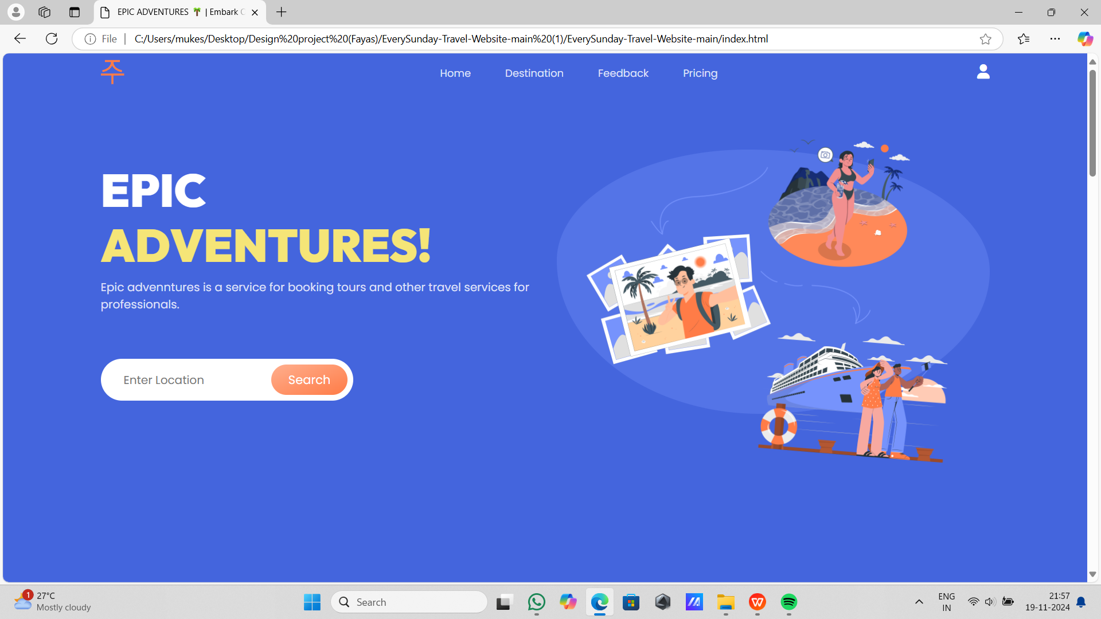
MODULE-2 HOME PAGE

Slide 17
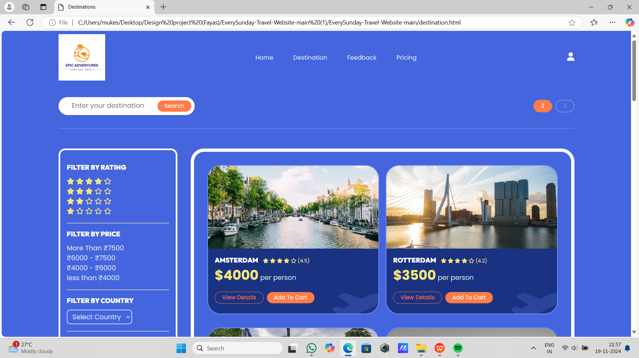
MODULE-3 DESTINATION PAGE

Slide 18
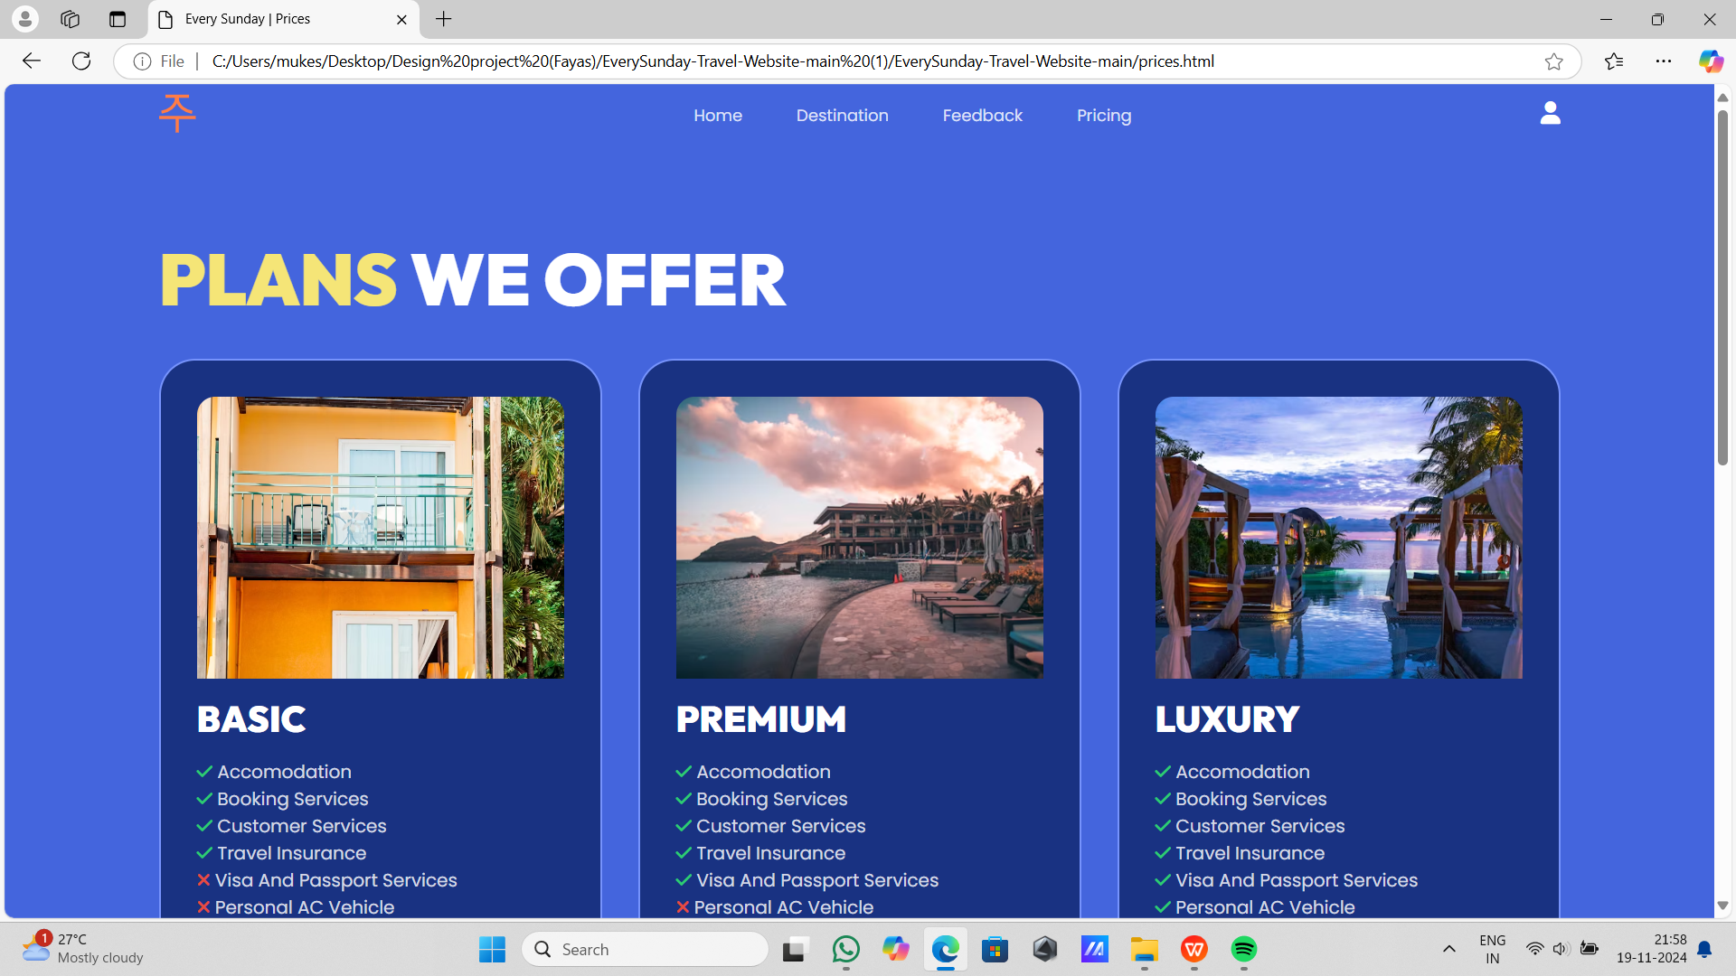
MODULE-4 PRICING PAGE

Slide 19
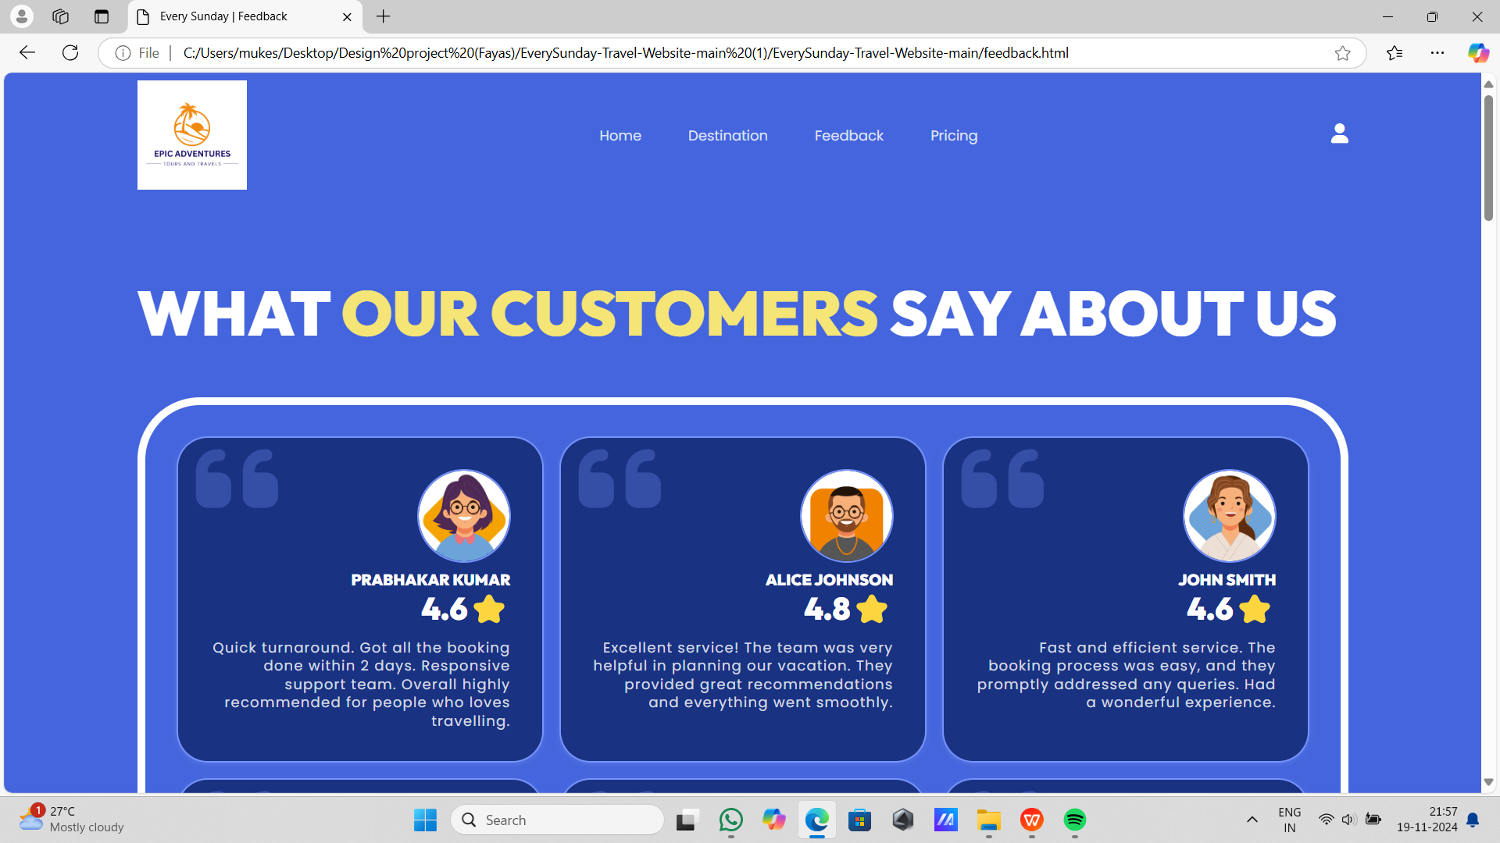
MODULE-5 CUSTOMER FEEDBACK

Slide 20
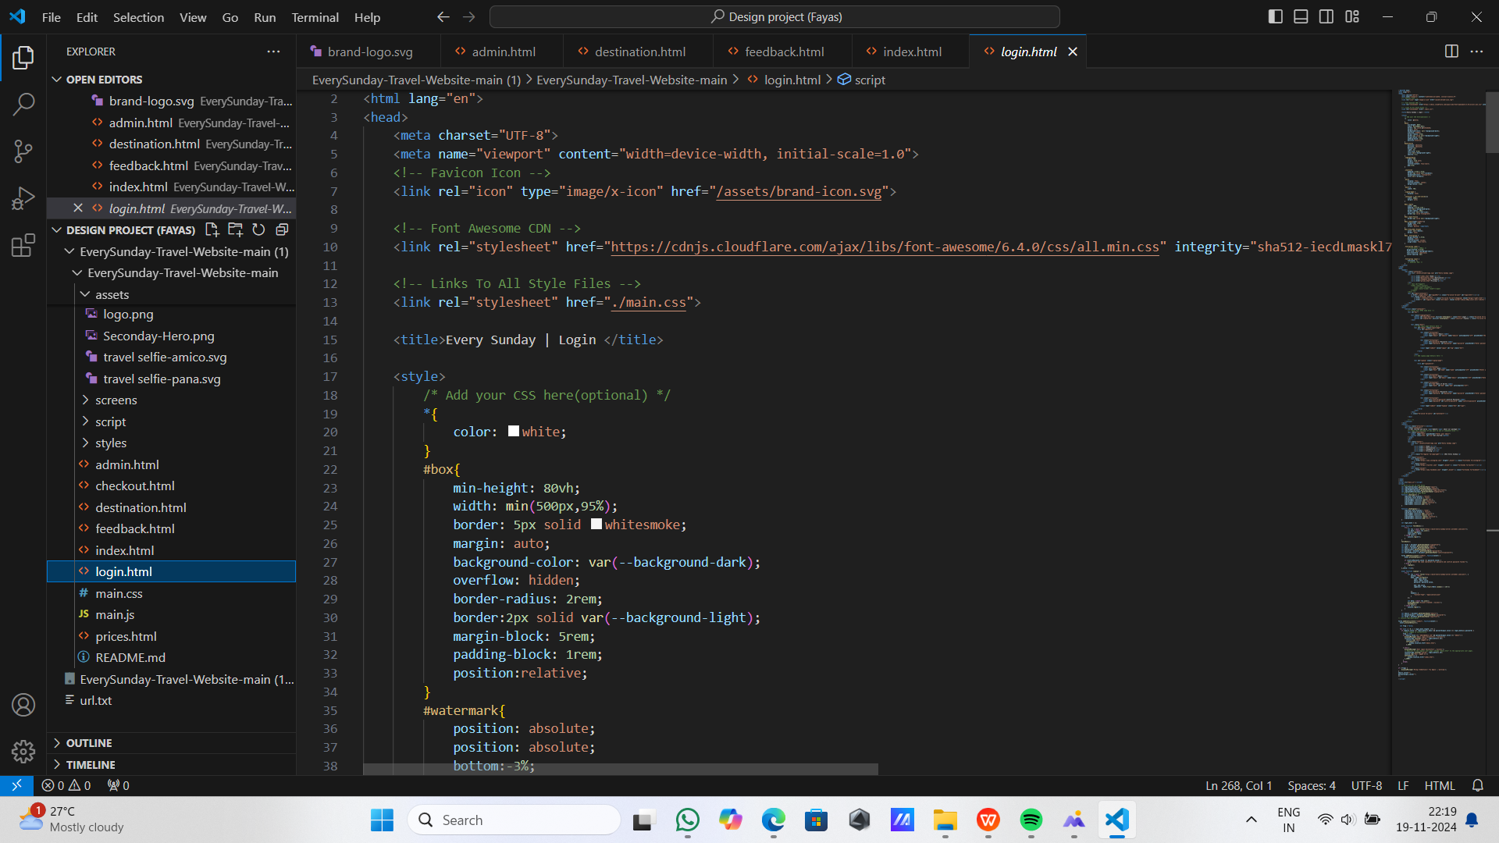
Html code in login (login.html)

Slide 21
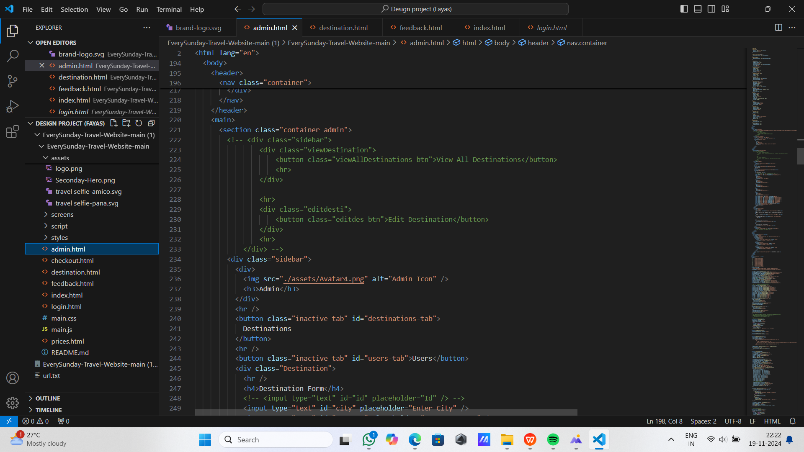
admin.html

Slide 22
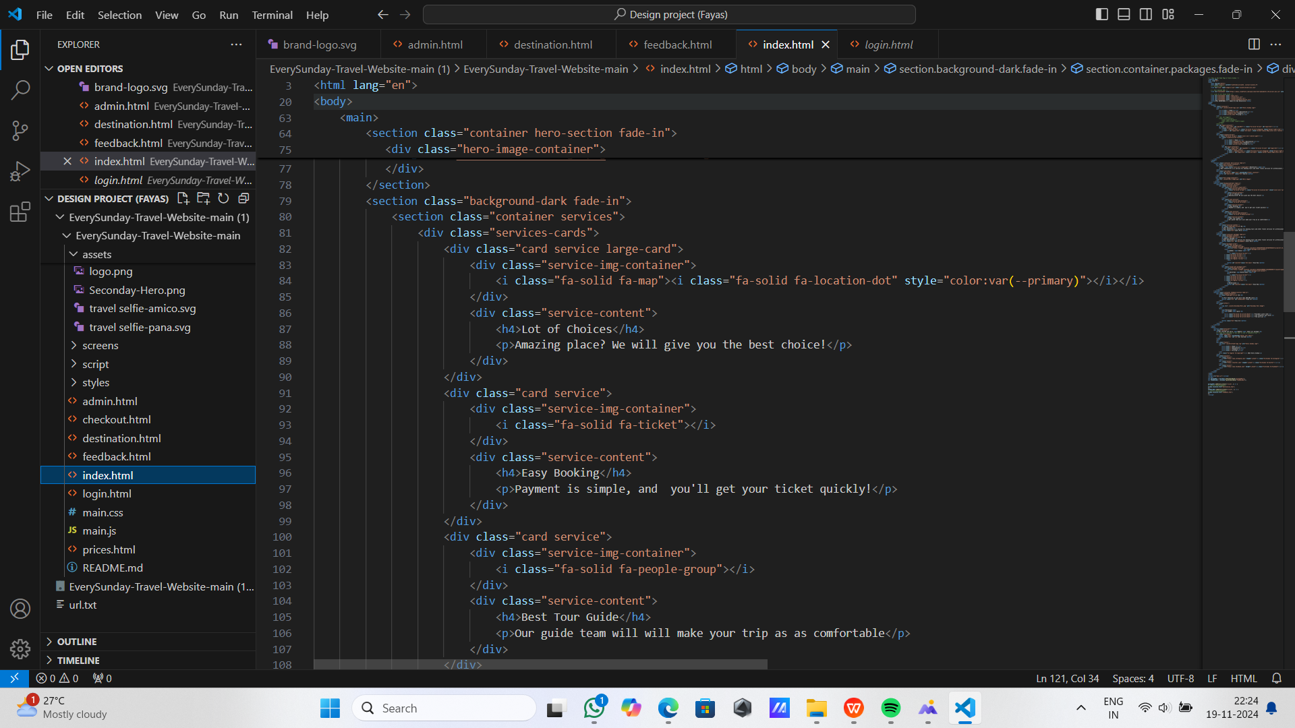
index.html

Slide 23
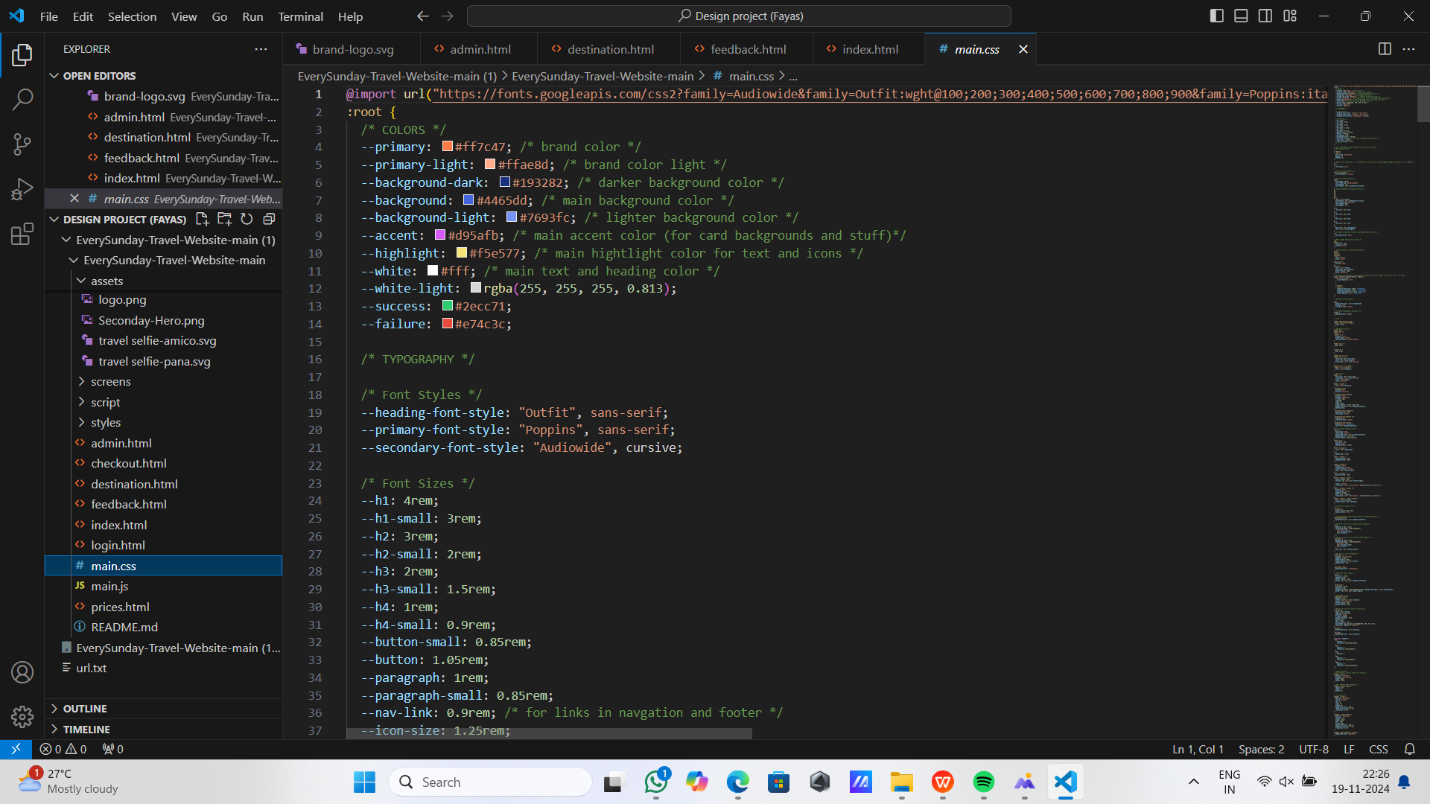
main.css

Slide 24
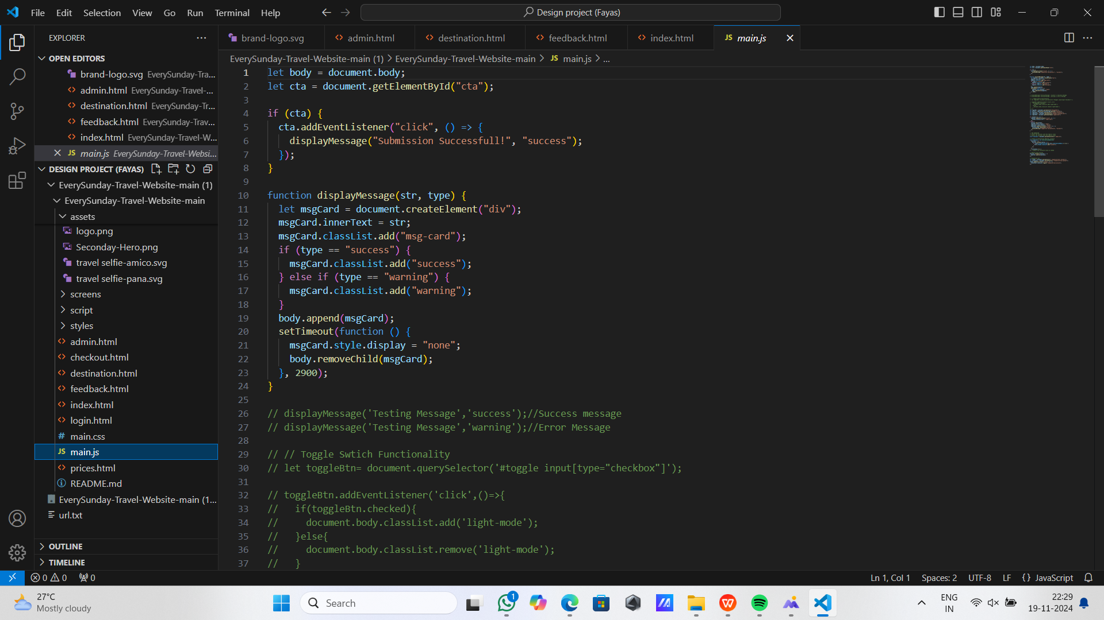
main.js

Slide 25
CONCLUSION
Effective tourism management is crucial for maximizing the benefits of tourism while minimizing its negative impacts.
The proposed system, with its innovative features and focus on sustainability, offers a promising solution for enhancing tourism operations and promoting responsible tourism.
In future directions, integration with emerging technologies such as Artificial intelligence for enhancing user experience

Slide 26
THANK YOU

